Slide 1
Islamic culture and civilization

Slide 2
Islam and human civilization
Among the first category of people of there is no permanent basis of joint cooperation they have to suffer a life which is based on the fact selfishness and desire .
In the 2nd category we see that many religious teachings have been degraded and in their present form in cable of guidence .
Buddhism and communism and many other religions do not provide holy bliss and does not cut off a person from the society.

Slide 3
ISLAM AND HUMAN CIVILIZATION
Man is a living normal and cultured being his life depends on support of other human beings .He can not reach or even the equipment of life without civilization.
There are two types of people inhabiting earth first is the group of those who take guidance from the supposition of the mental power and second those who seek leadership from shock and religious teachings

Slide 4
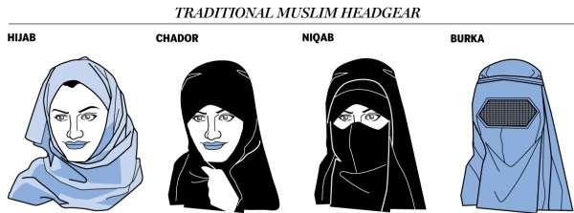

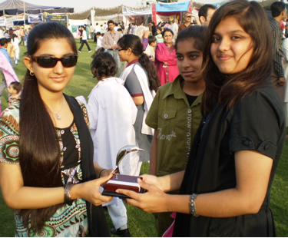

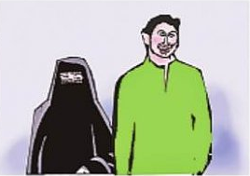
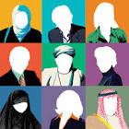
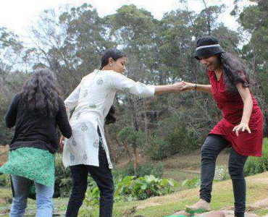


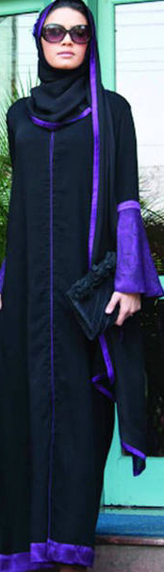
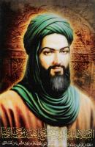
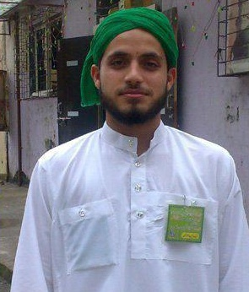
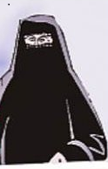

Islamic European Culture Moveing to Culture

Slide 5
Islamic person aspects
Islamic code of life is based all-powerful the world acting in unity has no right to alter or to change his laws . Because Allah is the maker of man and the universe.
The islamic code is detailed and systematic , a circle which has no aspect of human life however in significant ,over steps.
This code embraces political ,social , economic matters . His public and personal life,

Slide 6
Islam distinguishing aspects
Internatonal relation and laws are all confined in the Islamic system.
The reformation of soul and faith are:
oneness of Allah
Faith on the Holy prophet (P.B.U.H)
Faith on life after death

Slide 7
DISTINGUISHING ASSPECTS OF ISLAM
Islam strikes a balance between individualism and collectivism and every person is answerable to Allah . we are enjoined to live together not to forsake other but to help others and not to create difficulties for them
Complete balance
Islam, has kept a complete balance between different aspects numerous reformers and philosophers are divided between the world

Slide 8
DISTINGUISHING ASPECTS OF ISLAM
And the religion but Islam has kept a complete balance between all aspects of life
Simple and logical
In Islam there is no place for the worship of any being other than Allah,it,s teaching are very simple and practical unlike other religion no one have any exclusive rights in Islam

Slide 9
Distinguishing aspects of islam
Stability and change
Islam is the only religion which strikes balance between consistency and change which proves itself beneficial. The laws given by Holy Quran and Sunnah are eternal and the whole world acting in unision has no authority to bring any change. Islam has given such principal and laws to mankind that are for all times and which are not affected by the passage of time or change of climate.

Slide 10
DISTINGUISHING ASPECTS OF ISLAM
The Islamic view of life is revolutionary and reformative movement. Holy prophet (P.B.U.H) did not confine himself to just deliver the message of Allah .but for the welfare of man,He organized muslims in a society and made it obligatory that the creed should be propagated throughout the world

Slide 11
Verses of Holy Quran regarding civilization
We have given Adam respect and greatness we have given them air and sea for their means and granted live hood by clear and dignified things(Surat Bani Israel Ayat :70)
We have granted superiority over all creatures (Bani israel)

Slide 12
Verses of Holy Quran regarding civilization
It is up to Allah who to grant wisdom and without doubt wisdom is a great blessing of Allah .only people with wisdom Accept
Preaching of Allah(Surat al Baqra Ayat no 269)

Slide 13
Verses of Holy Quran regarding civilization
We have created human in the best shape yet he has fallen in to pits but the people who accepted Islam and did good deeds there is a great bounty for them(Sorat al yaqeen ayat 2-4)

Slide 14
Thank You

